Slide 1

Internship Summary
Amelia Brown
1/13/20 – 7/22/20

Slide 2
StoneCrest Center
StoneCrest Center is an inpatient psychiatric hospital located in Detroit.
We take people in crisis from all over Michigan.
Typically people come straight from the ER or are petitioned to come by a therapist, doctor, police officer, case worker, etc.
People can also voluntarily admit themselves.

Slide 3
What to Expect
The average length of stay at StoneCrest Center is 7-10 days, but they can be longer or shorter depending on the situation.
Stays vary on diagnosis, cooperation and participation in the program, and availability in housing or placement after leaving the facility.
Patients are expected to see their doctors, take their medications, participate in groups, practice good hygiene, and eat all of their meals.

Slide 4
Group Therapy
In addition to art therapy groups, patients are offered various clinical group therapy, activity therapy, music therapy, and social groups several times a day.
Art therapy is offered and is considered to be part of the activity therapy department.
The art therapist at StoneCrest right now is also a clinical therapist, so she has many other responsibilities including a case load.
StoneCrest is currently looking for an art therapist to work in the activity therapy department again.

Slide 5
Group Art Therapy
Some examples of groups I have lead on my unit at StoneCrest Center:
Affirmation Trees
Road Drawing
Peaceful Place
Dream Catchers
Ugly Art
Torn Paper Images
Distorted Coloring
Outside/Inside Boxes
Blackout Poetry

Slide 6
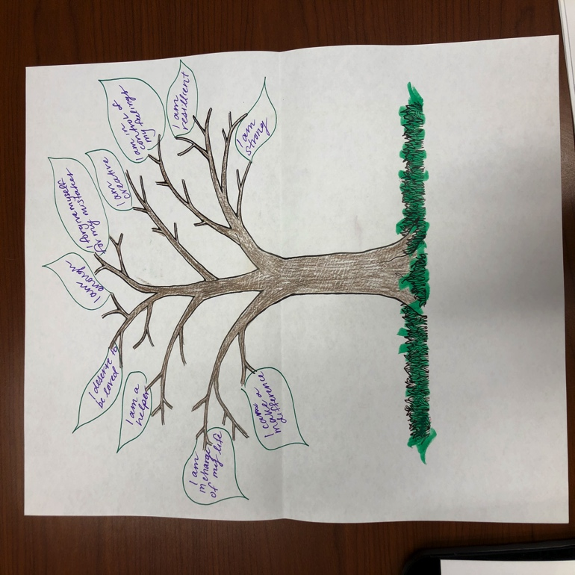
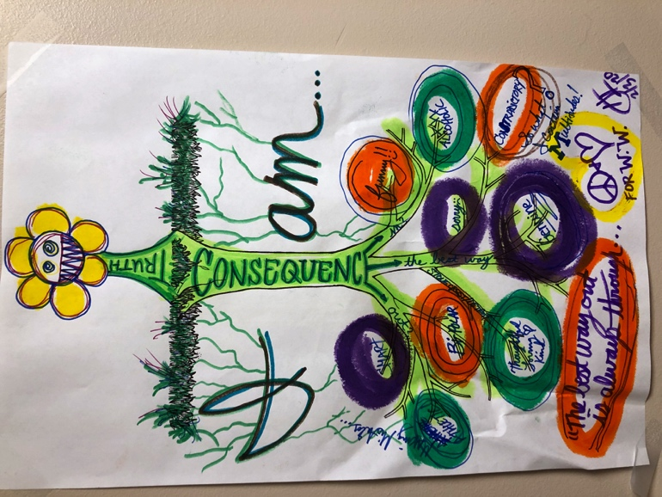
Group Art Therapy
Affirmation Trees
Client receives an outline of a tree with no leaves, and a list of positive affirmations.
They are to either choose affirmations from the list, or make up their own, and add them to the tree and decorate it.
The tree and affirmations represent them.

Slide 7
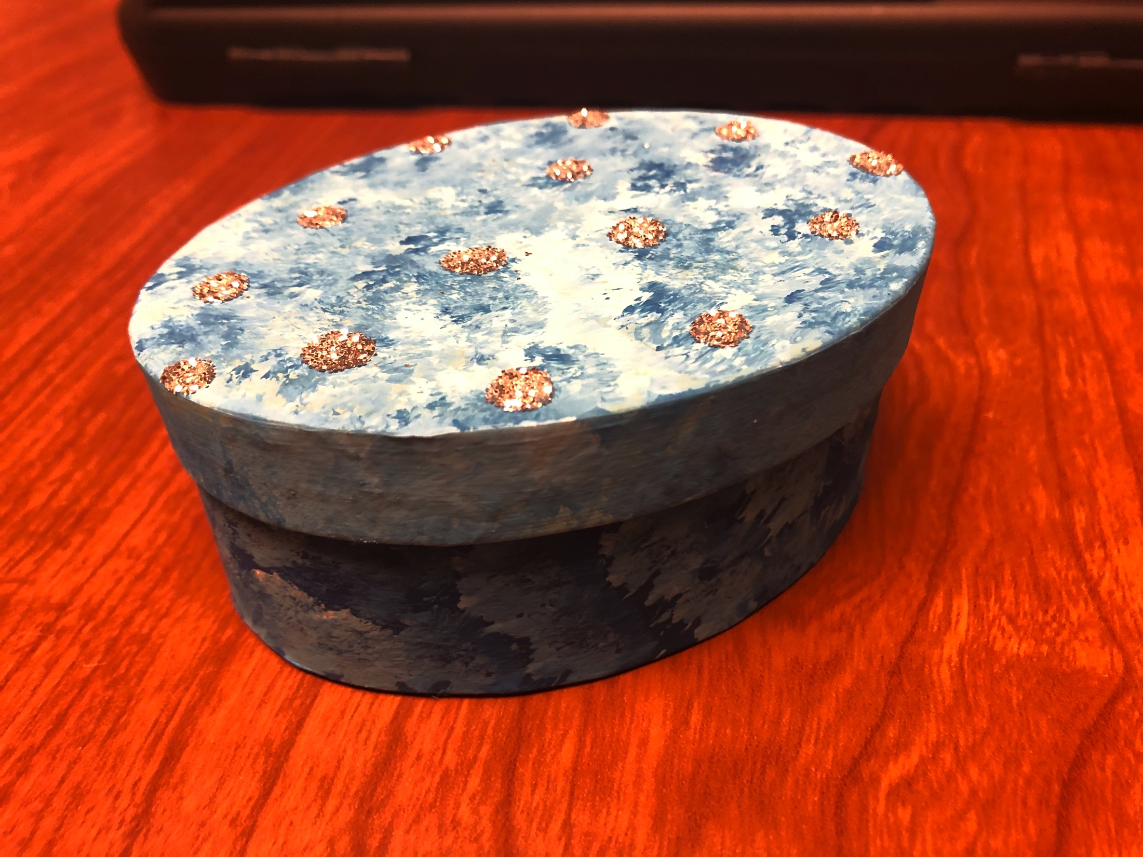
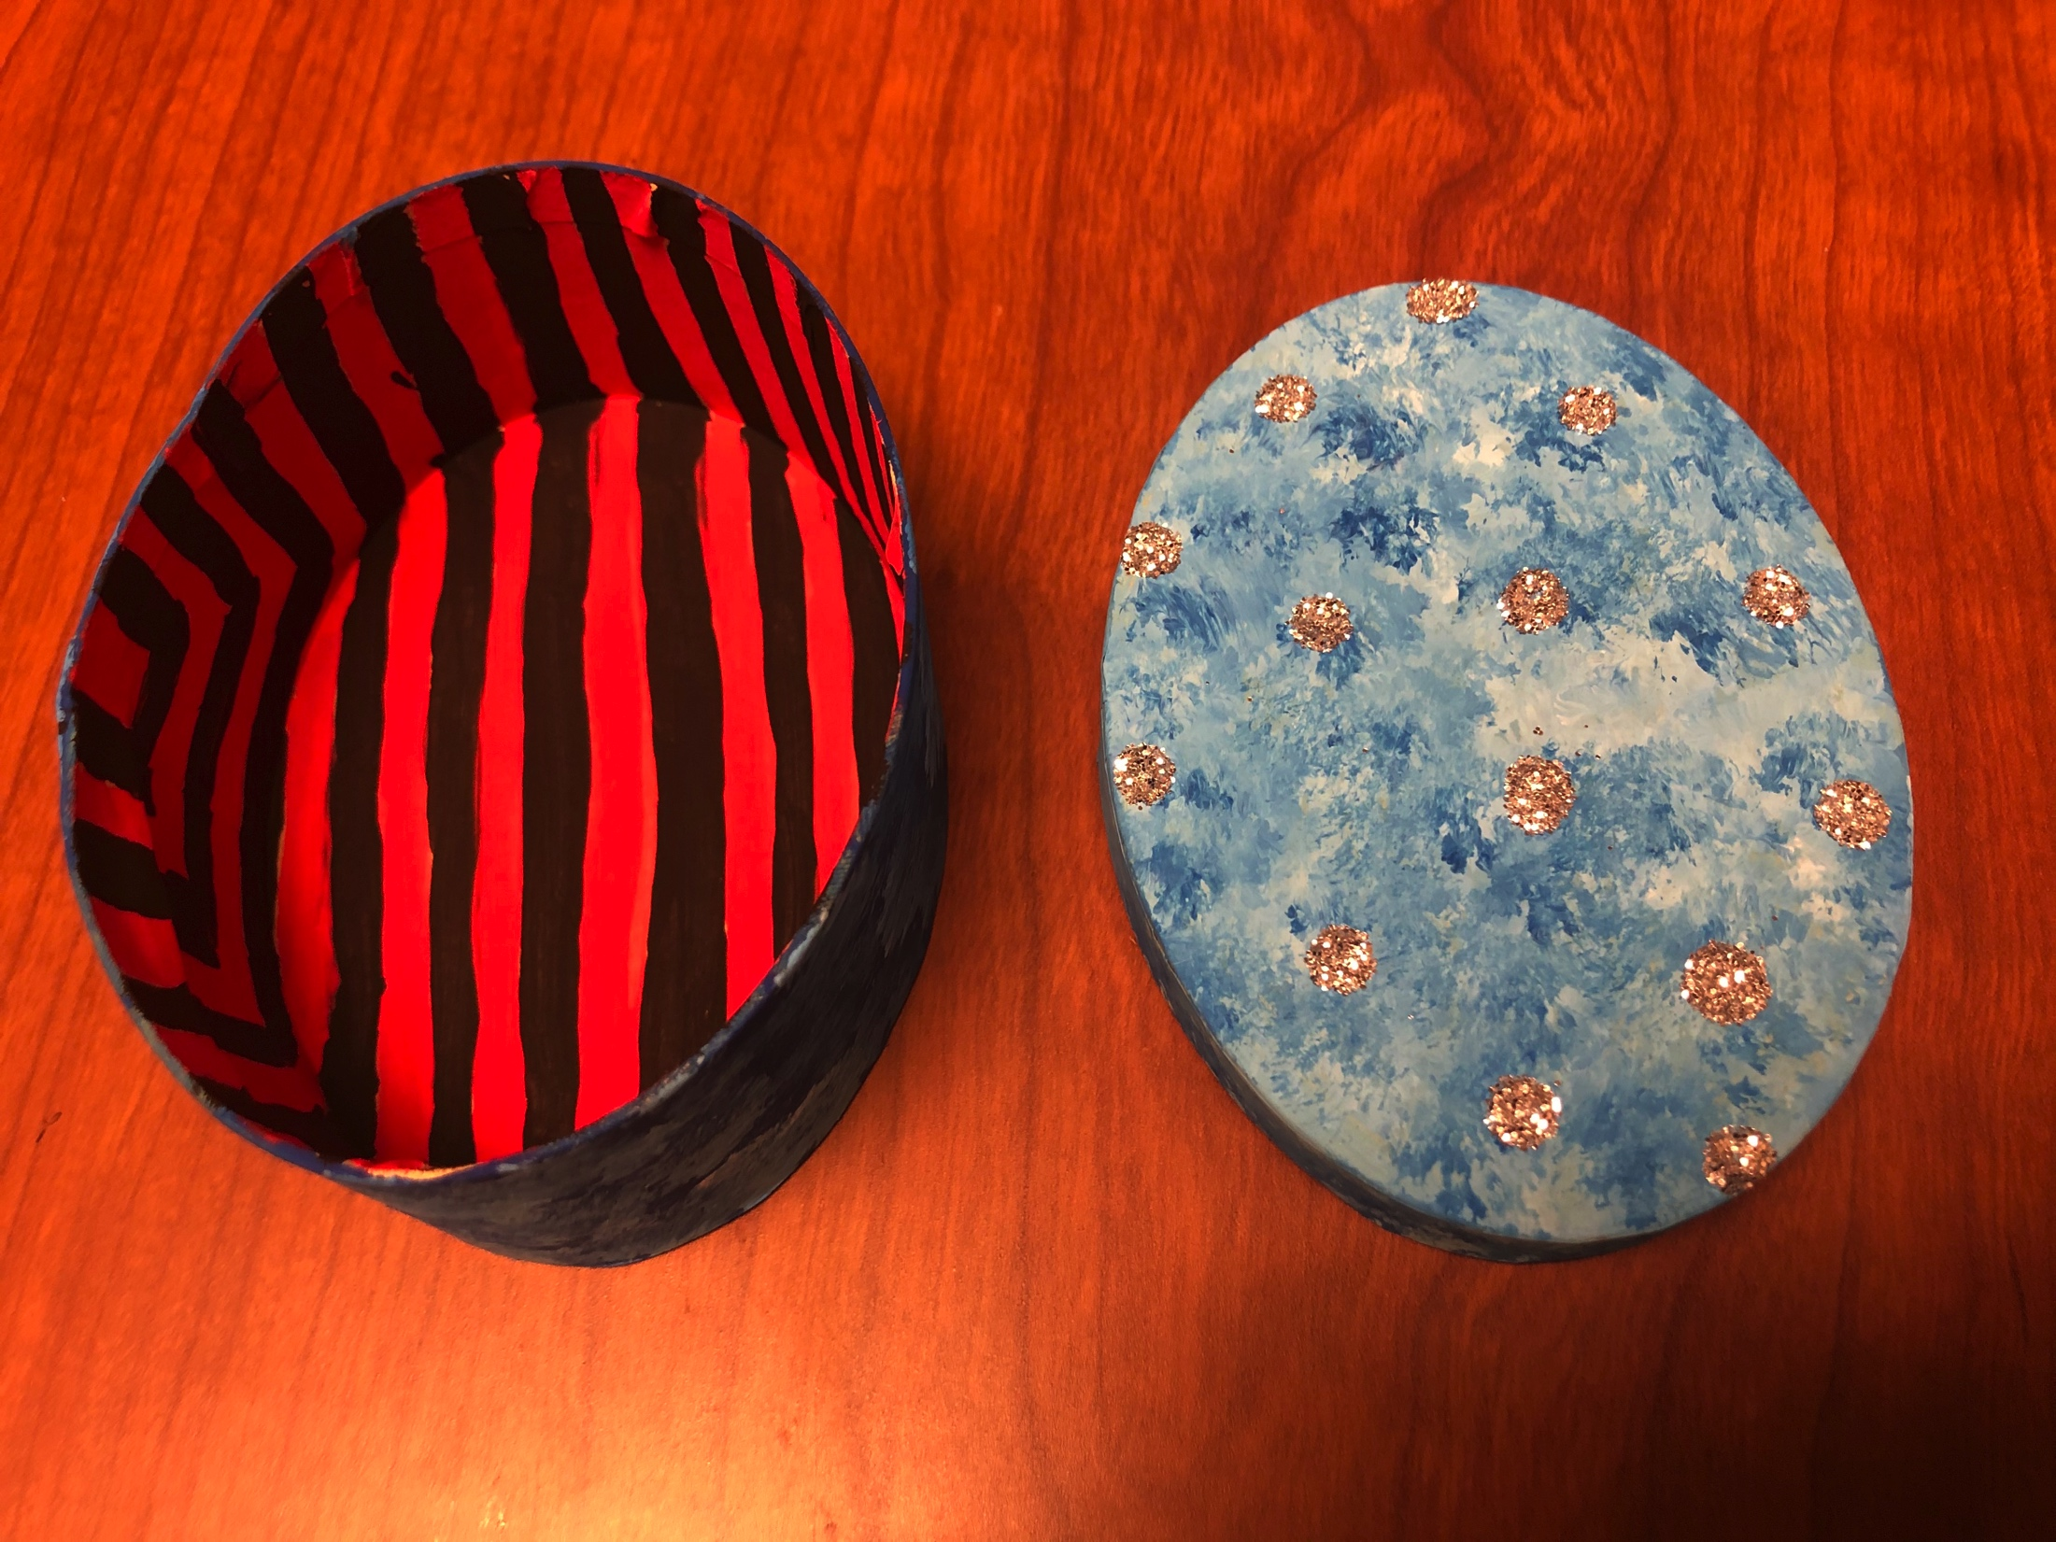
Group Art Therapy
Inside/Outside Boxes
The outside of the box represents what you put out to the world, and the inside is your true inner self.

Slide 8
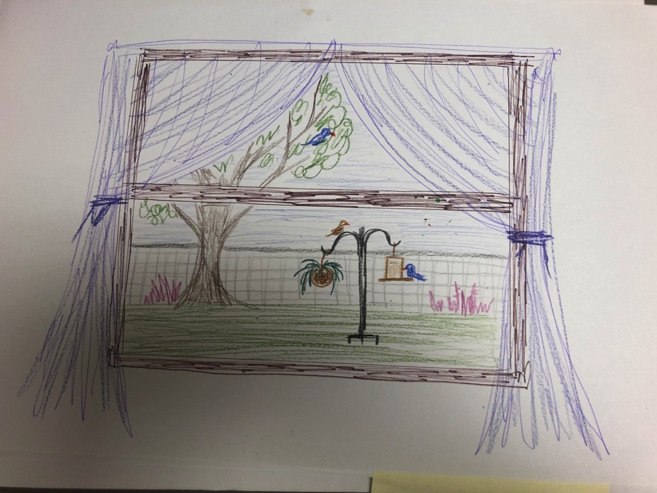
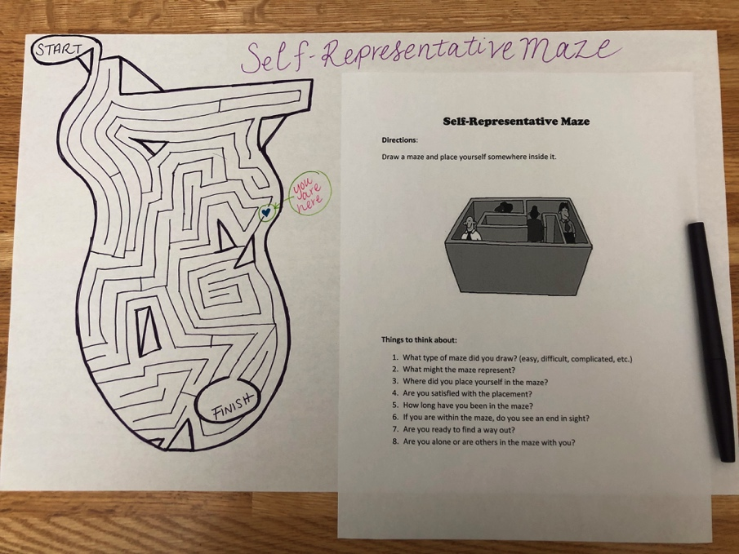
Group Art Therapy
“Peering Out”
“Self-Representative Maze”

Slide 9
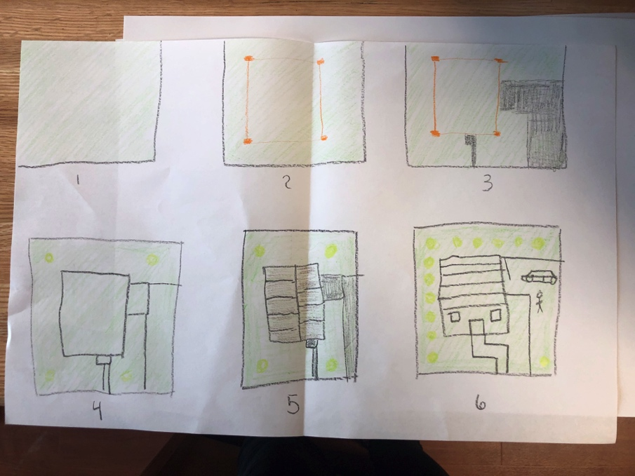
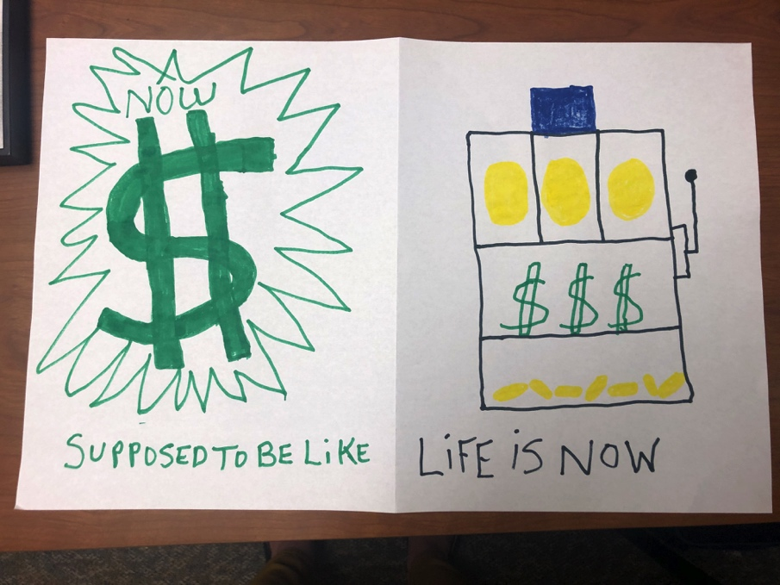
Group Art Therapy
“Growth and Self-Awareness”
“Expectation Vs. Reality”

Slide 10
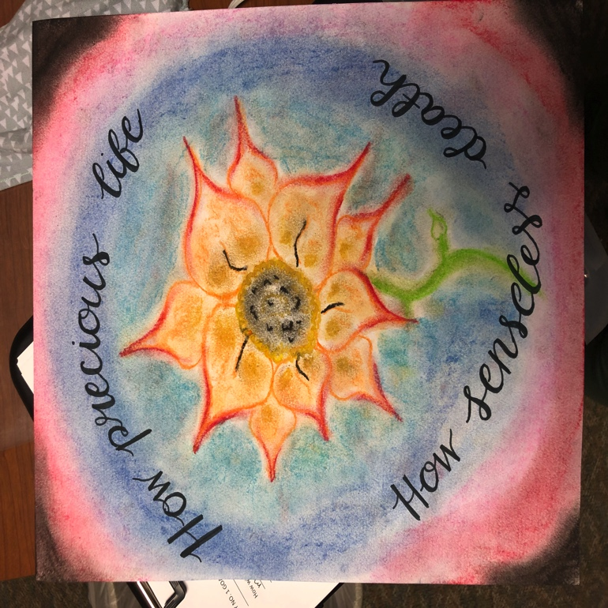
Individual Art Therapy
One of my favorite projects that I did with a client at StoneCrest was a goal drawing.
I thought it was appropriate for this setting because I had a client who was going through a lot of life changes and was working on figuring it all out while he was in the hospital.
I created a worksheet to help him get started and afterward he made a drawing to represent it.
He created this sunflower to represent the goal and asked me to do the calligraphy.

Slide 11
Responsive Art Piece
Altered Book
I decided to make an altered book as my responsive art piece to internship.
I wanted my journey to be able to be told as a story, because I knew that was what I would be going through there.
I was able to document each week or each significant feeling/event on a different page, and what I was going through and feeling on that day.
I found it to be a very effective way to document my internship.

Slide 12
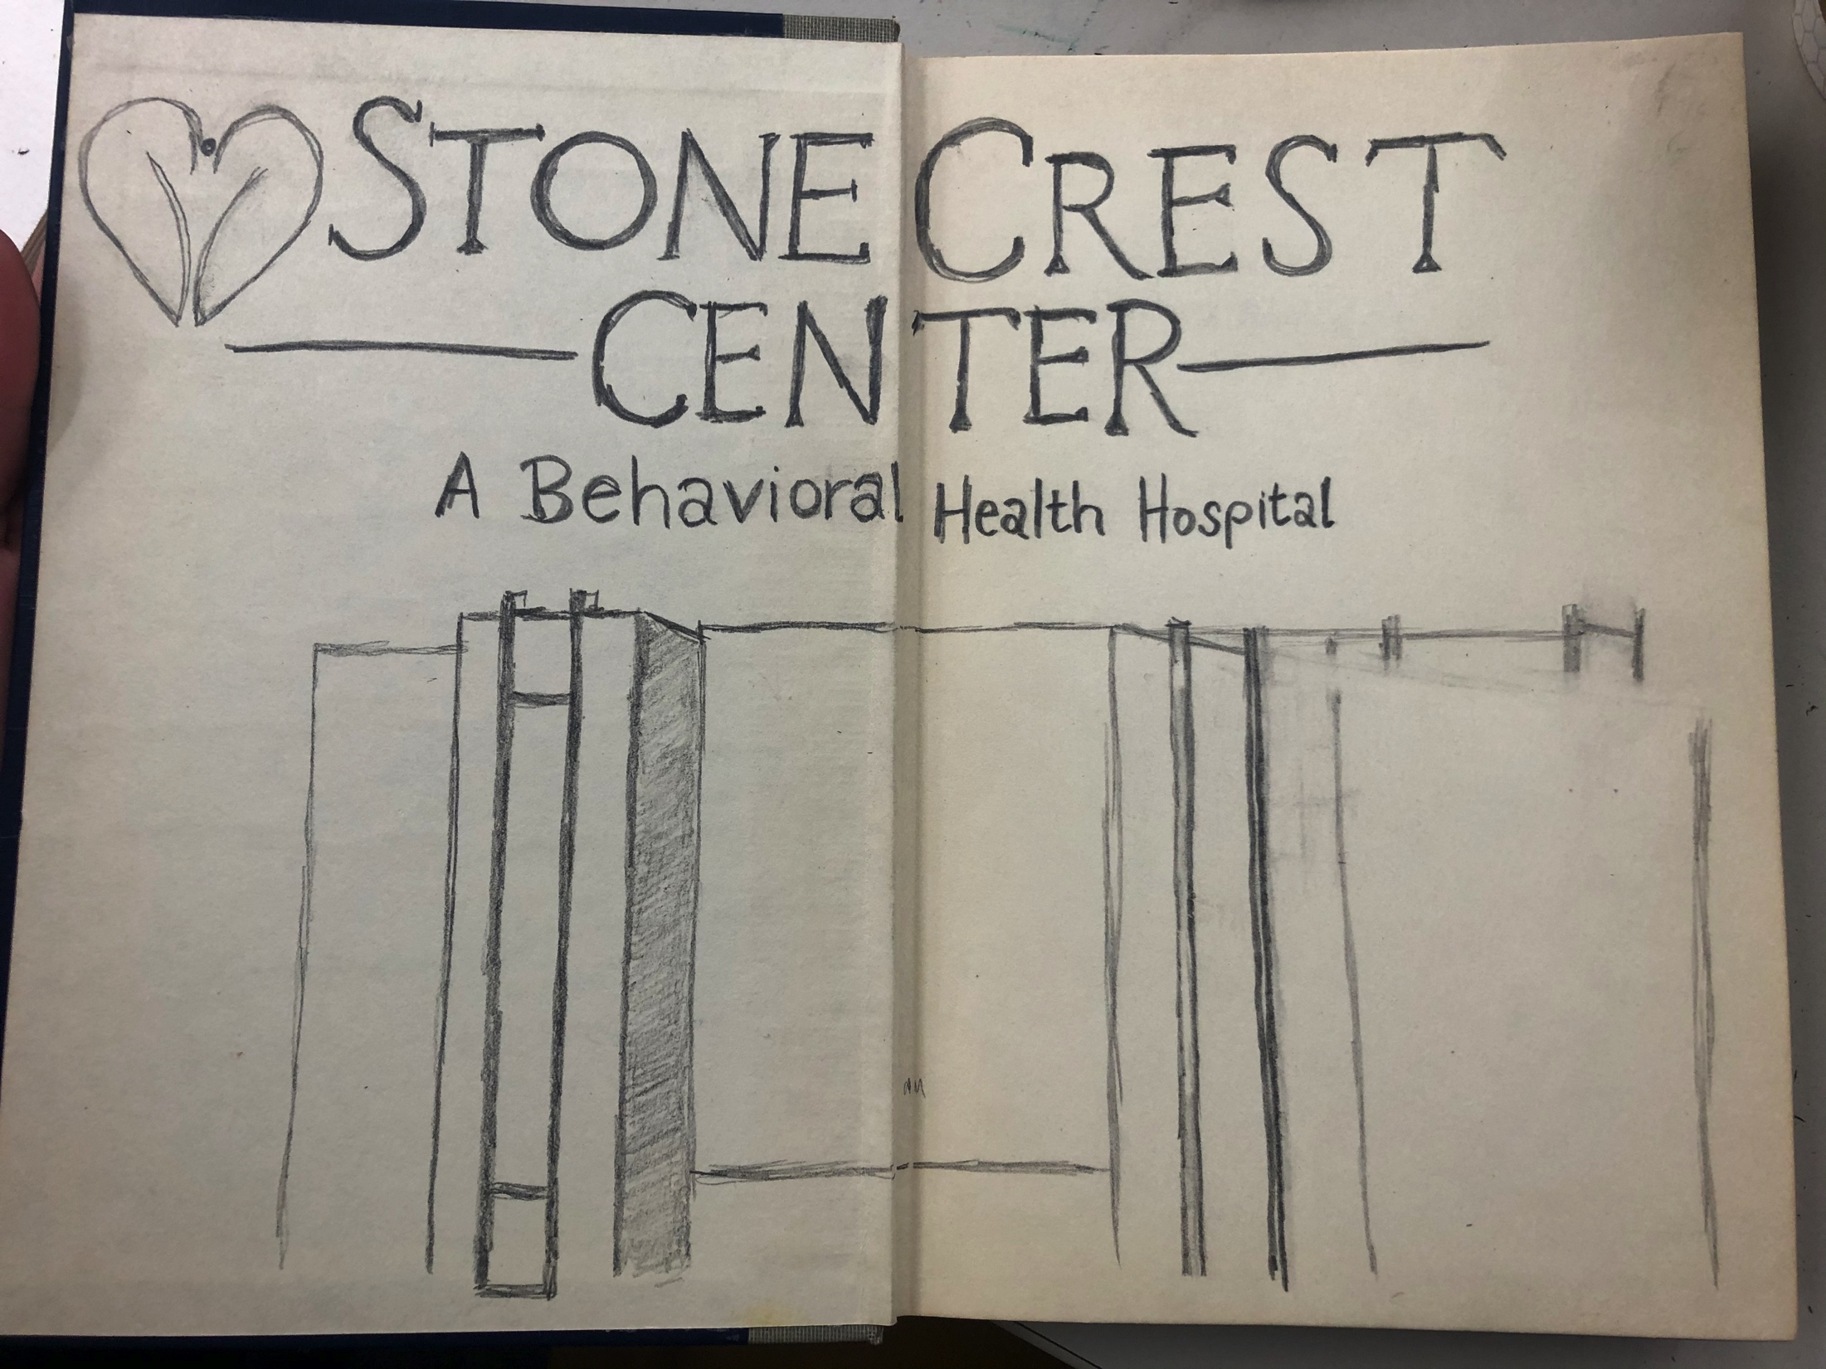
January 24, 2020
This was after my first week at StoneCrest. Our first whole week was training, I had to go through the same training as the employees so it took several days.
I didn’t exactly know what to think yet and I think this first page really shows that.

Slide 13
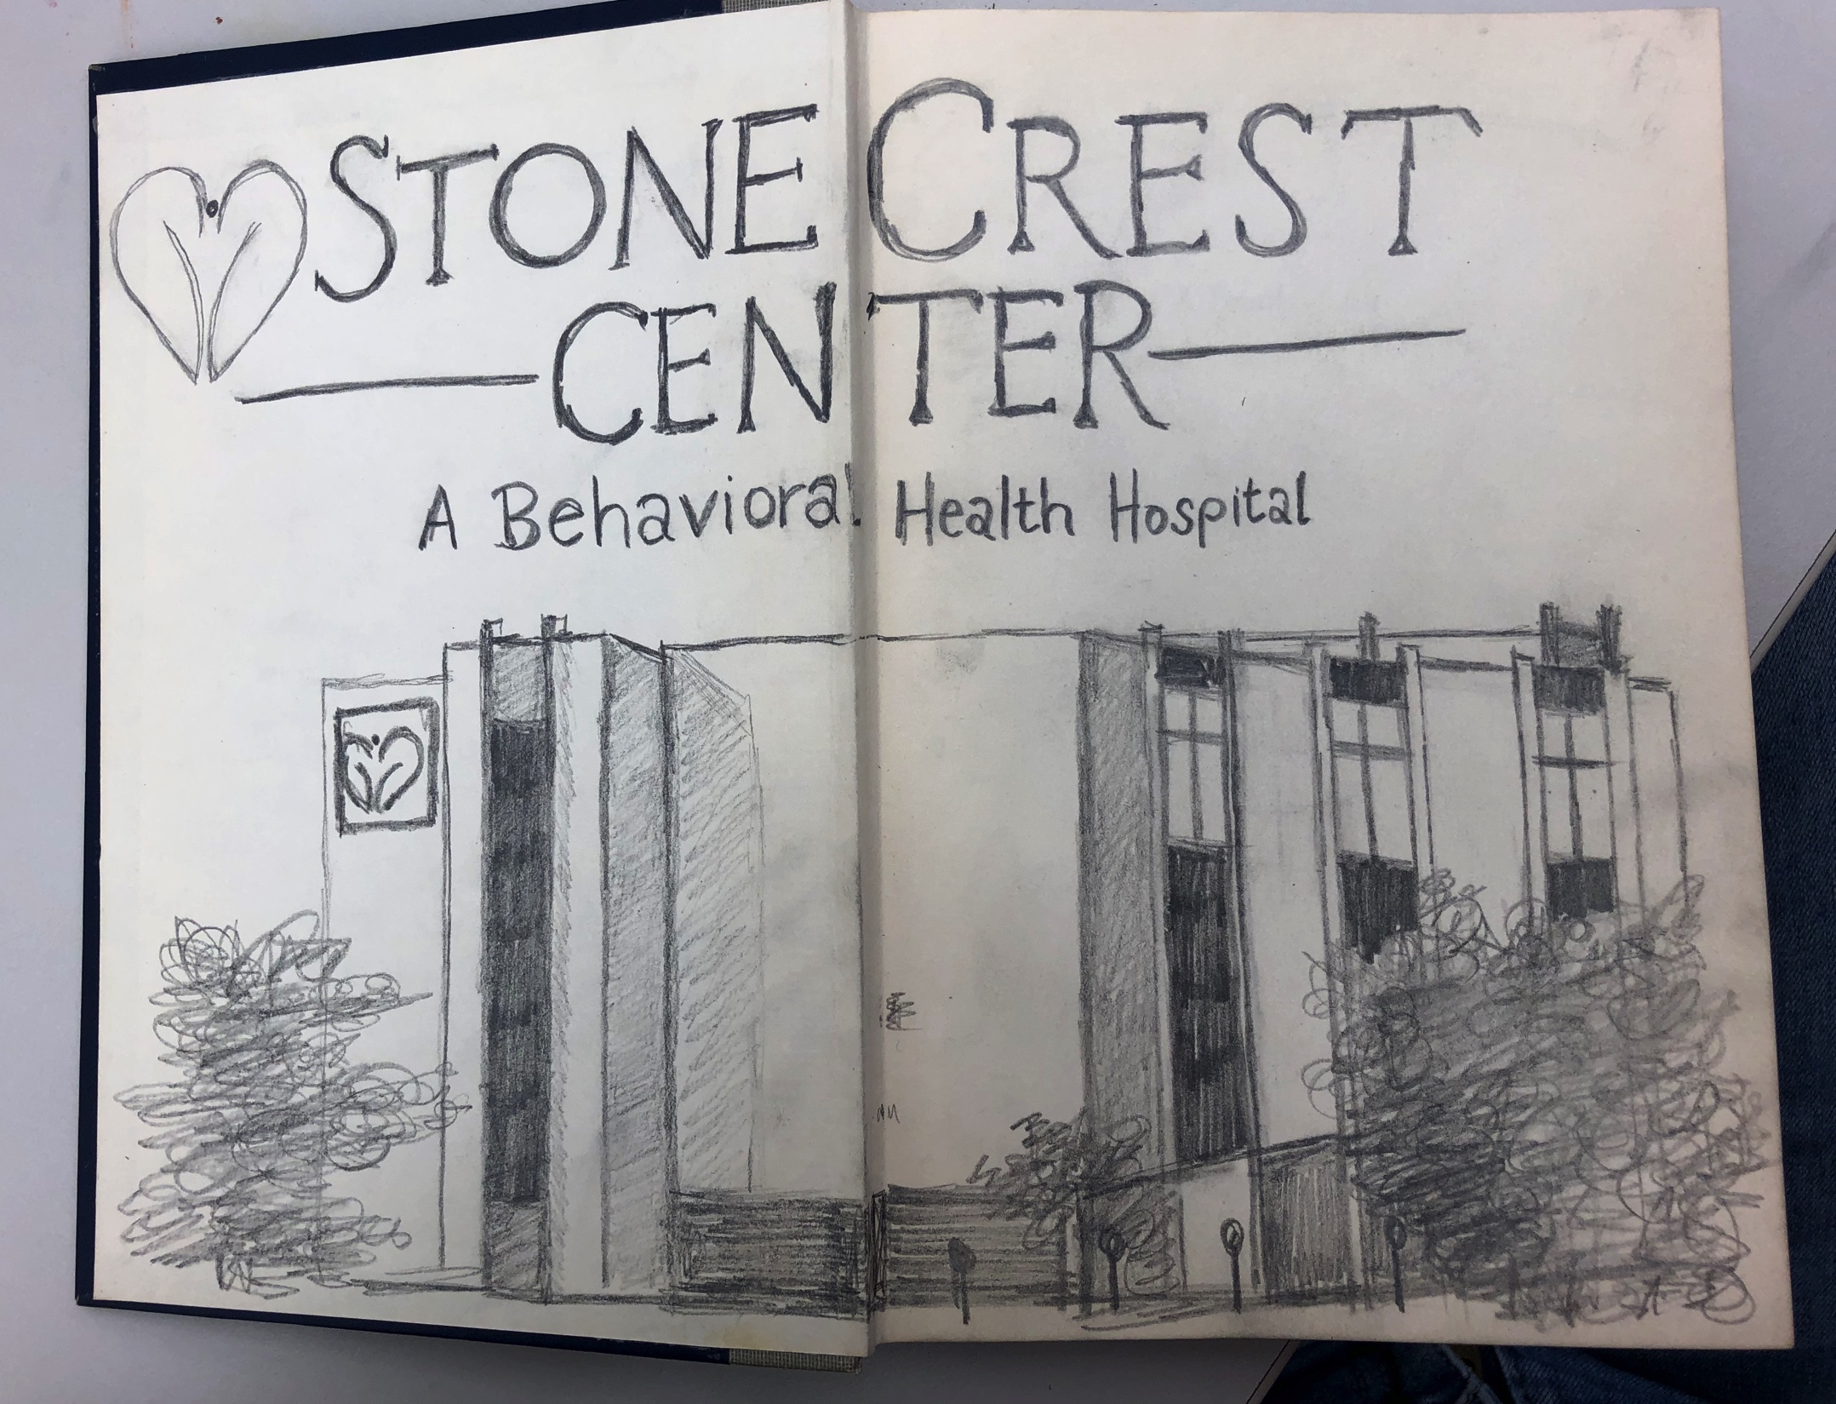
February 7, 2020
Two weeks later I was starting to get a handle on how things were. I finished the sketch of the building.
I chose to use pencil because it is a medium I never use and this placement seemed familiar yet out of my comfort zone.

Slide 14
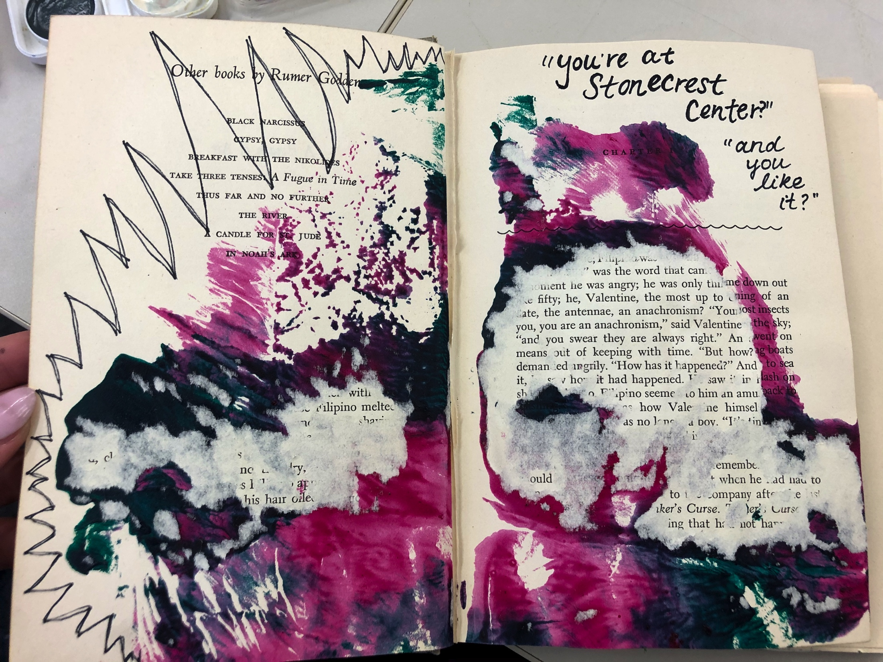
February 7, 2020
This week, I was truly trying to find myself at StoneCrest. I was starting to fall into a rhythm but also feeling sort of replaceable.
I didn’t know what art to make on my piece for the week so I used the art experiential we were learning that day for inspiration.

Slide 15
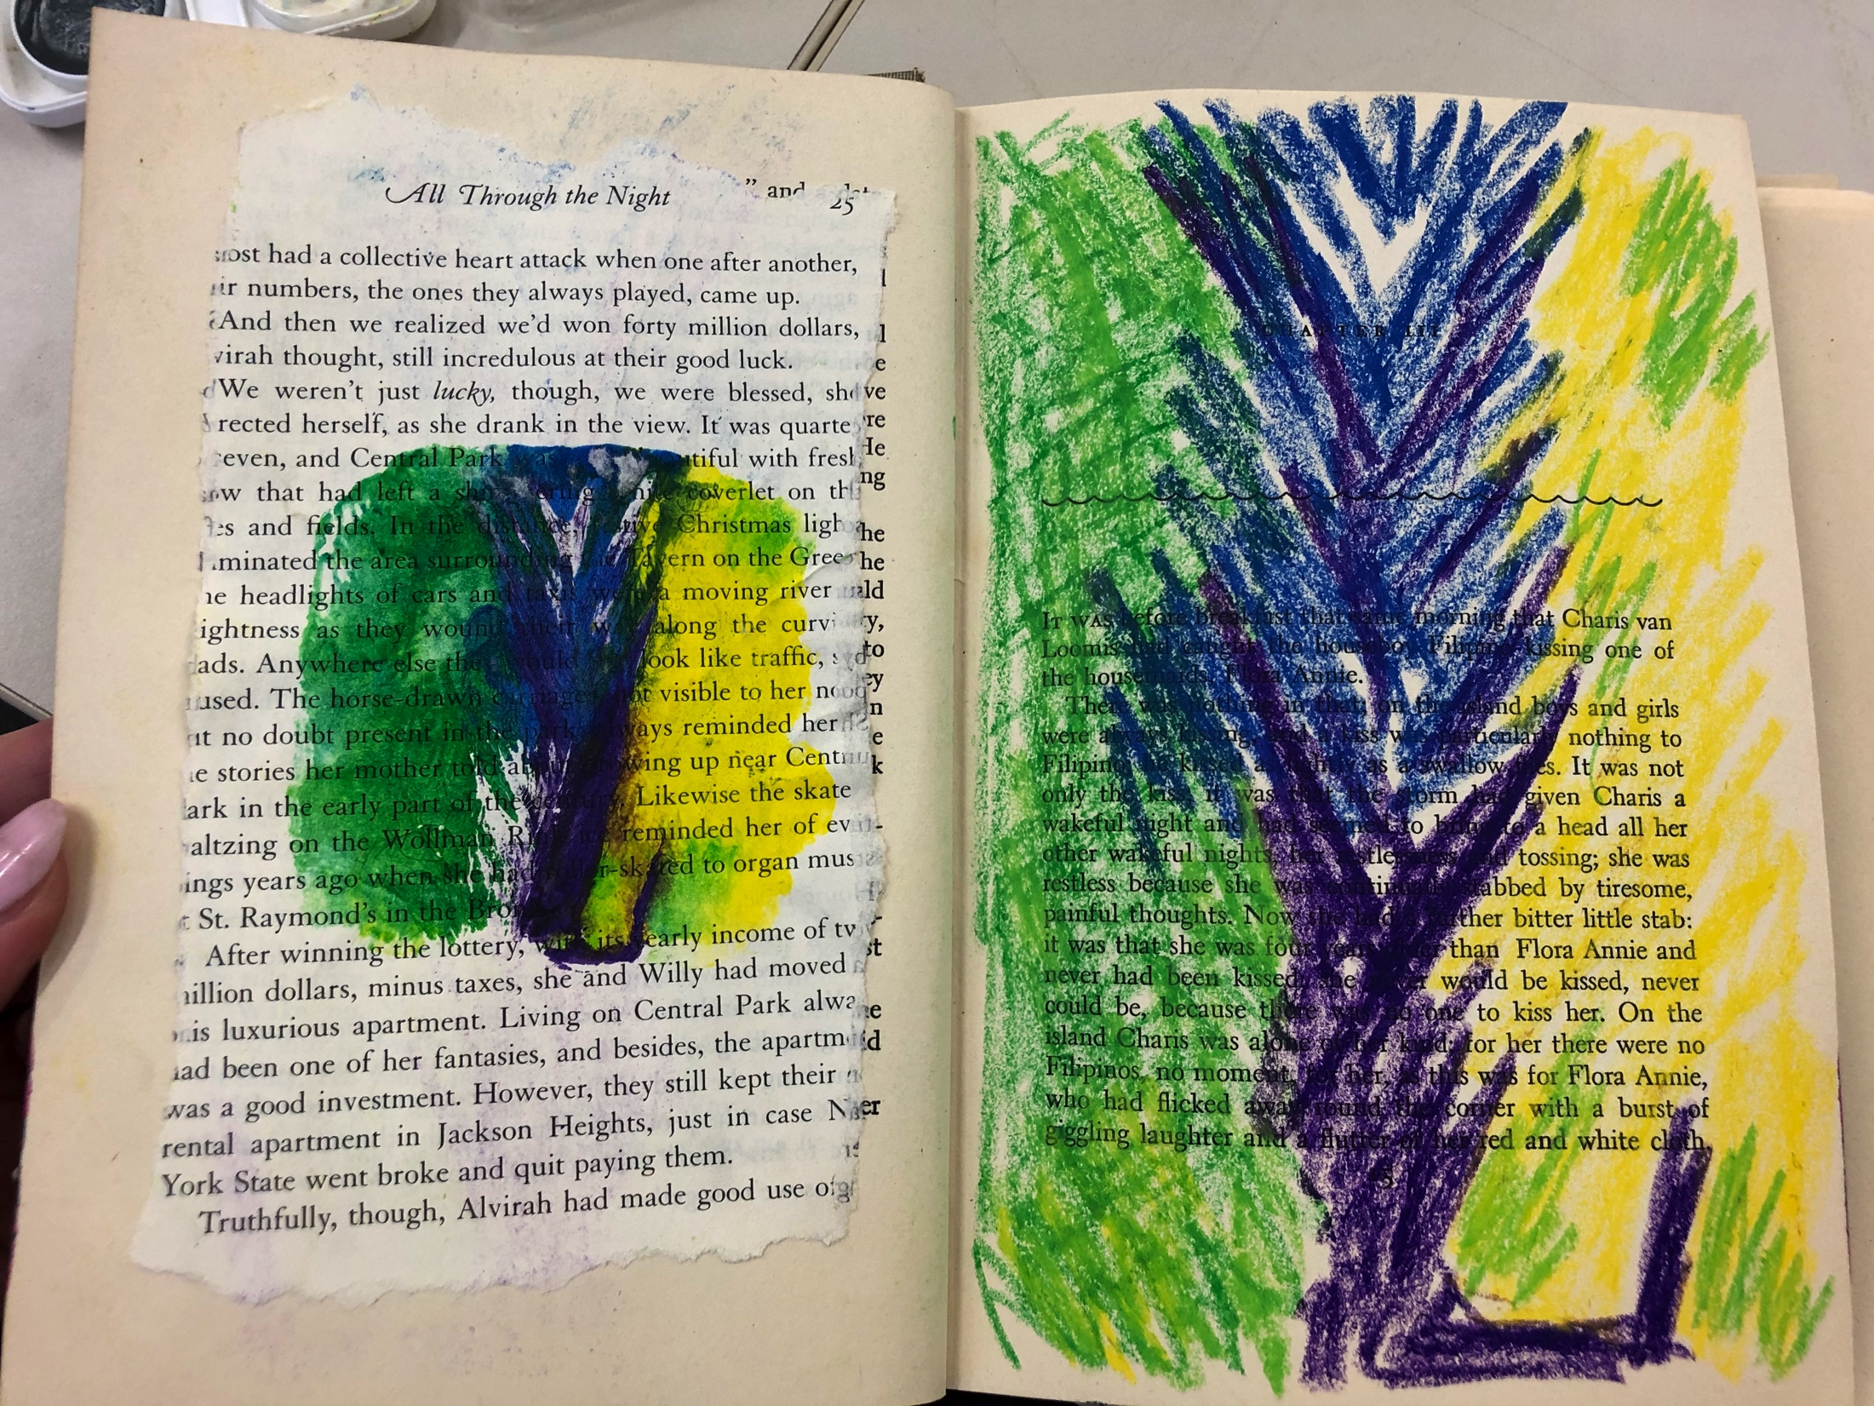
February 21, 2020
This was another responsive art piece using the printing we learned in class.
Afterward, I made a copy of the drawing in pastel.
I think it represented me trying to fit in at StoneCrest and as an art therapist.

Slide 16
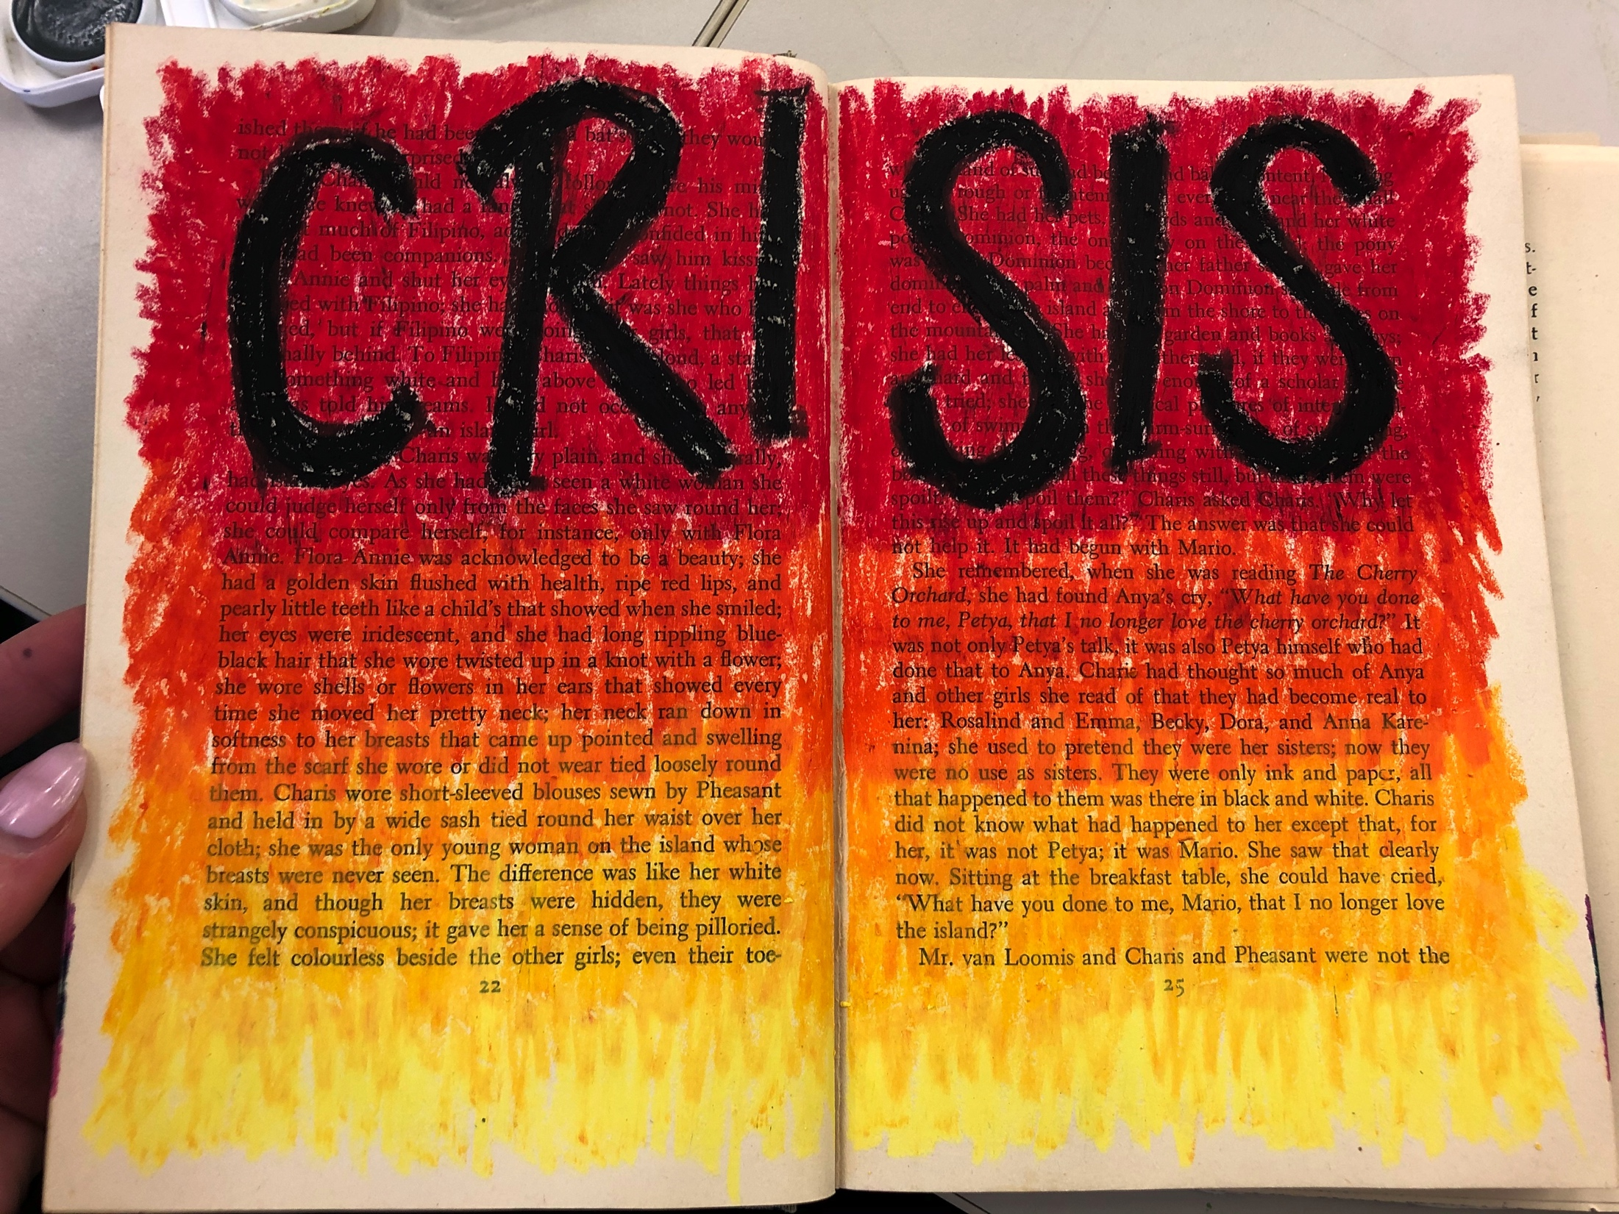
February 21, 2020
This was a hard week for my patients. There were a lot of people in and out that needed a lot of help.
I stuck with pastels because I am comfortable with them and I needed some security this week.

Slide 17
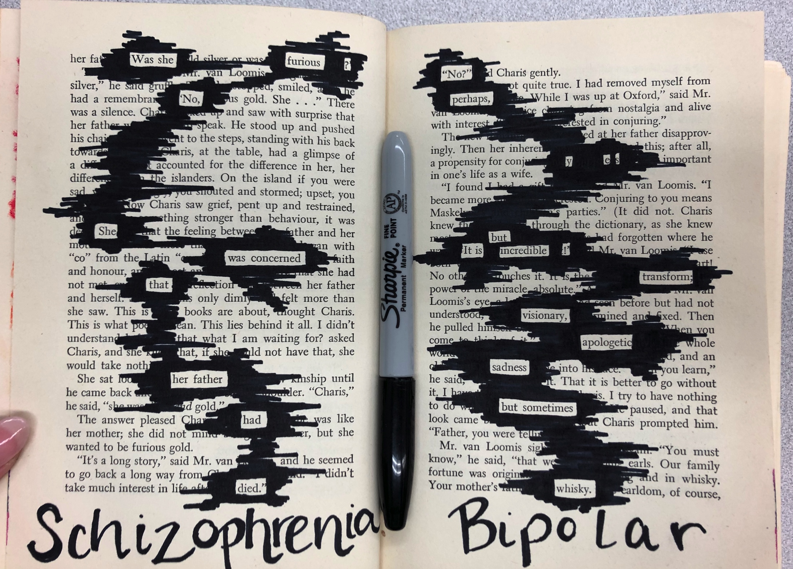
March 6, 2020
This week I had my group do blackout poetry.
To be fair, I decided to try it in my altered book this week.
I came up with two different poems that I thought described perfectly what most of my patients go through daily.

Slide 18
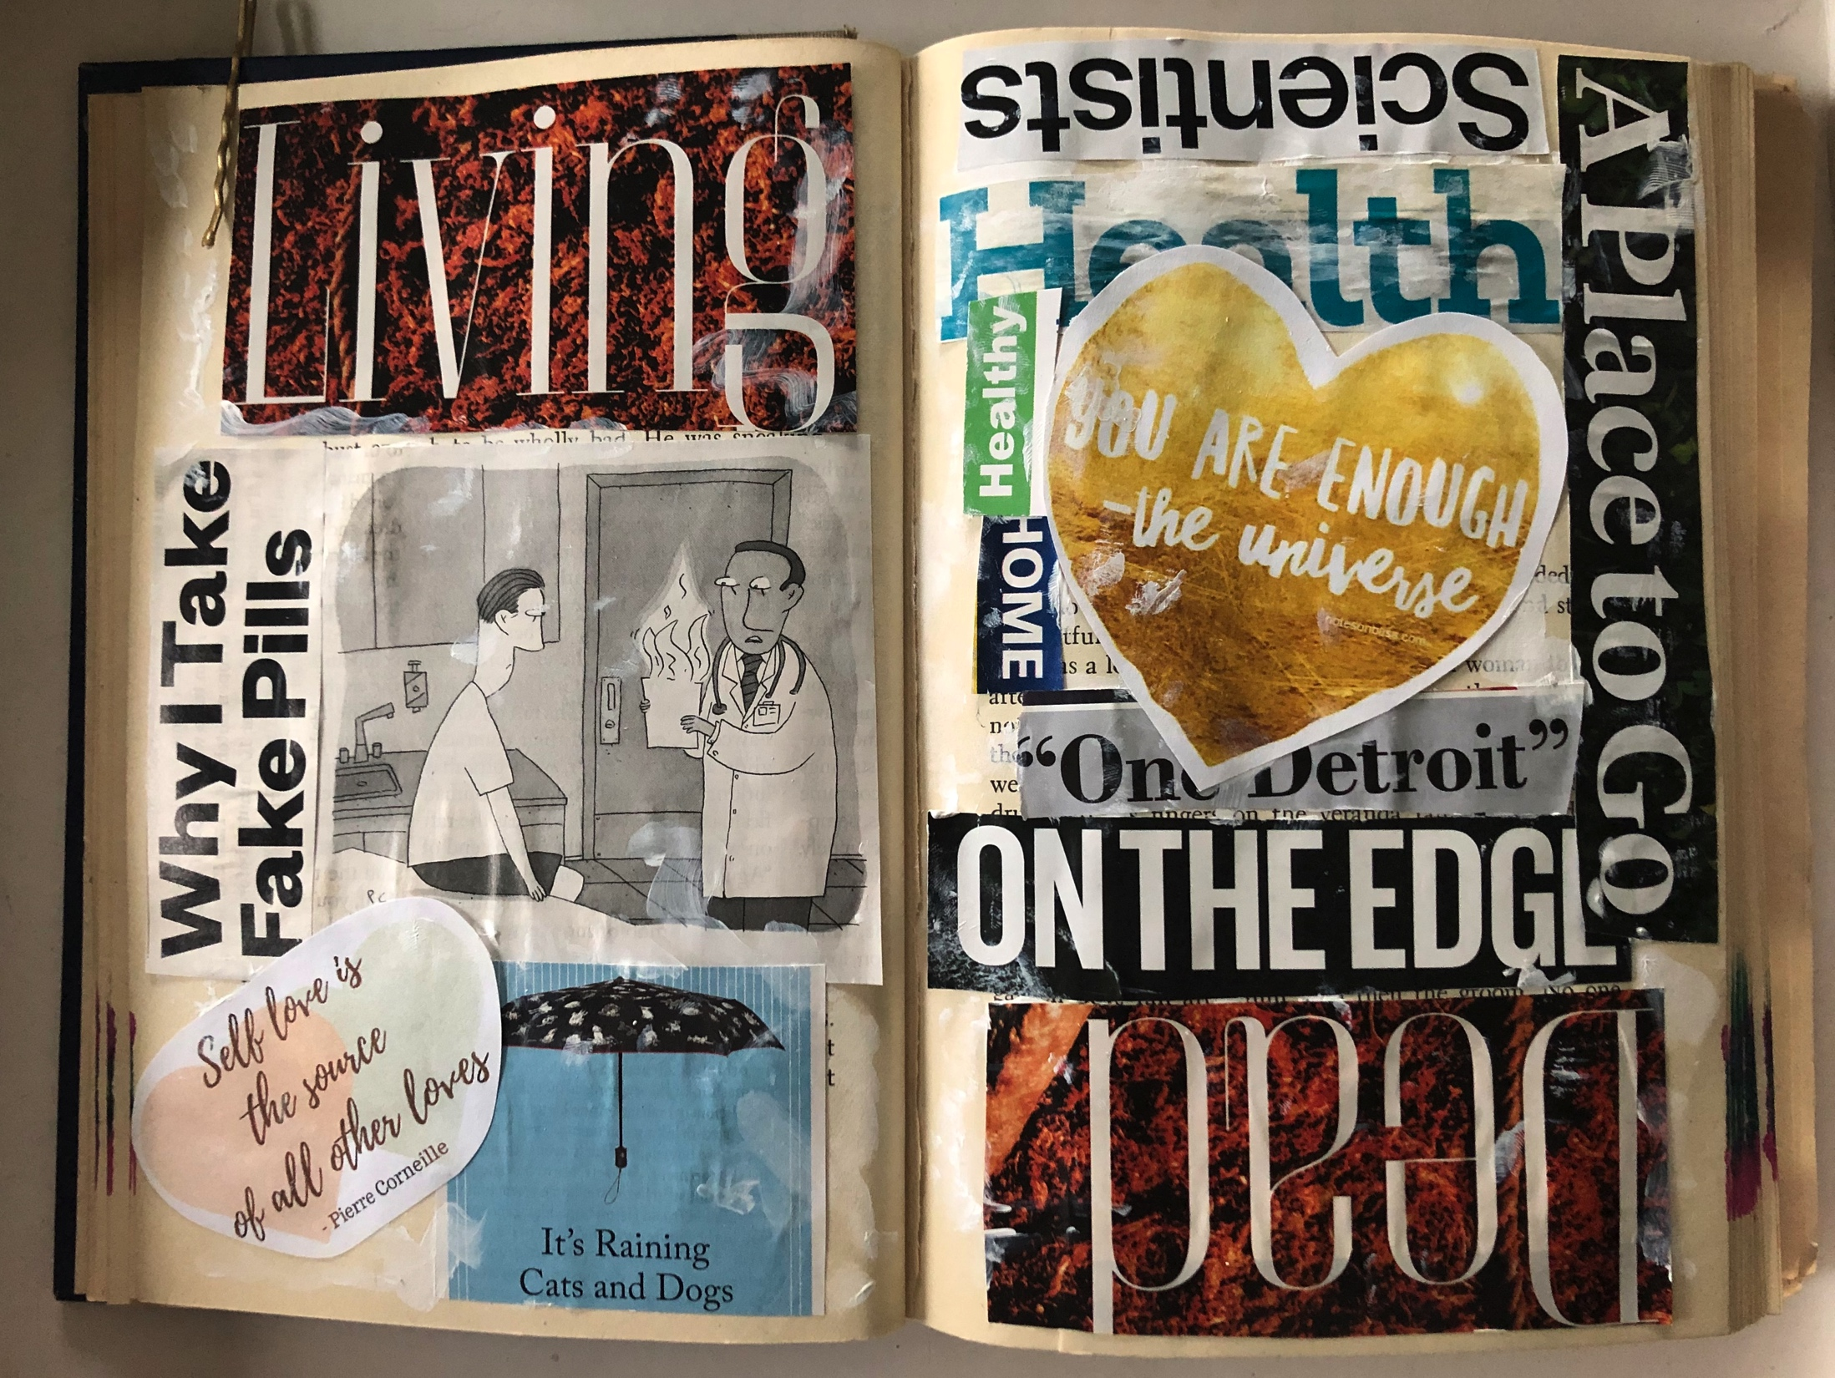
March 16, 2020
Coronavirus has everything shut down. I’m still going to StoneCrest because they really want me there.
Today I decided to do some collage as a stress reliever.
These are all words and photos I already had cut out that I thought were relevant with my patients.

Slide 19
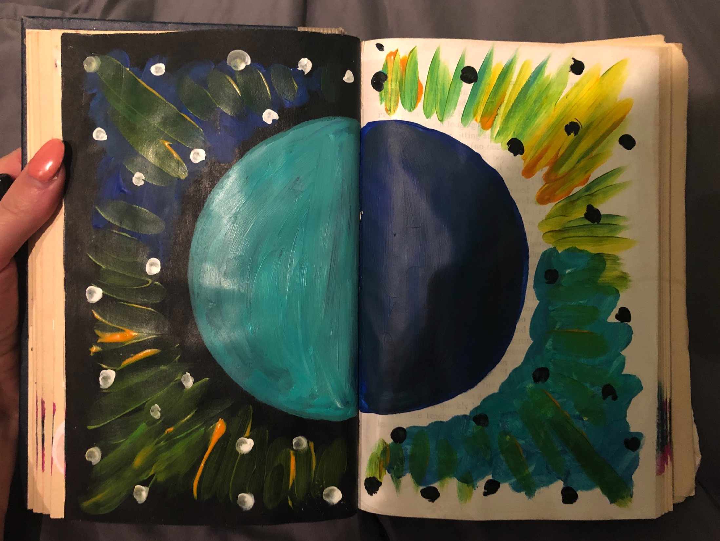
March 16, 2020
I used acrylic paint in my book today as well.
I’ve been getting more creative in my groups and trying new things with my patients.
I am definitely getting more comfortable in leading groups that ultimately may fail.

Slide 20
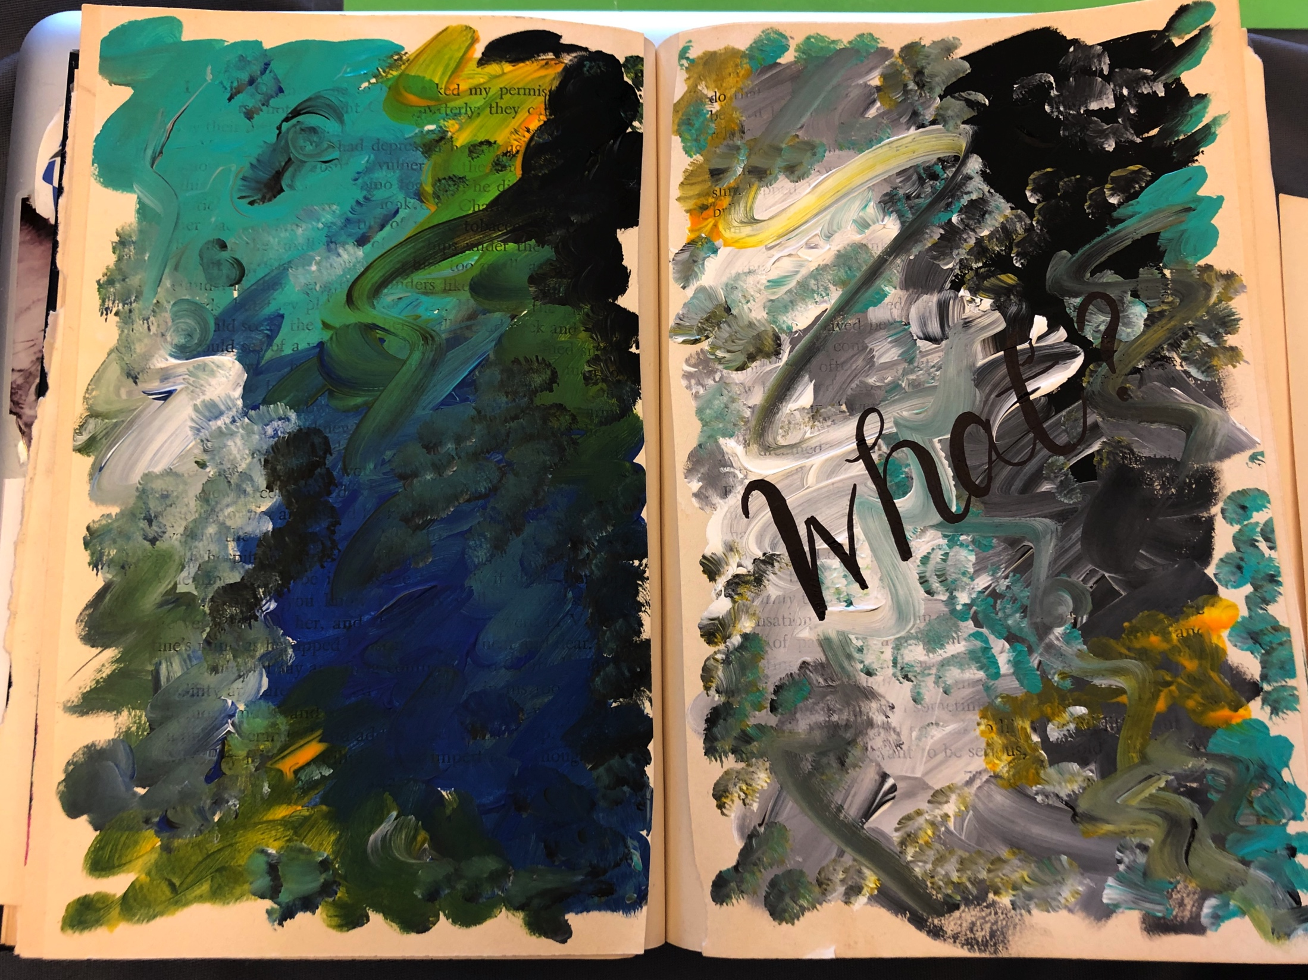
March 16, 2020
Everything is kind of crazy with the Coronavirus so this was a reflection of that.
Everything at StoneCrest Center is on edge with one unit being a quarantine.
What is happening??

Slide 21
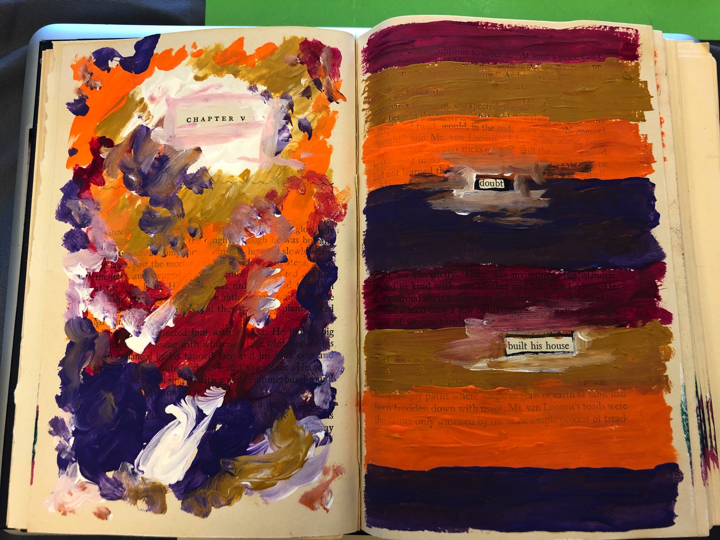
March 20, 2020
Another acrylic paint response to the night and day craziness that Coronavirus has brought on this life.
I made this with leftover paint from another piece I was working on. I feel inspired to use leftover paints to make new things.

Slide 22
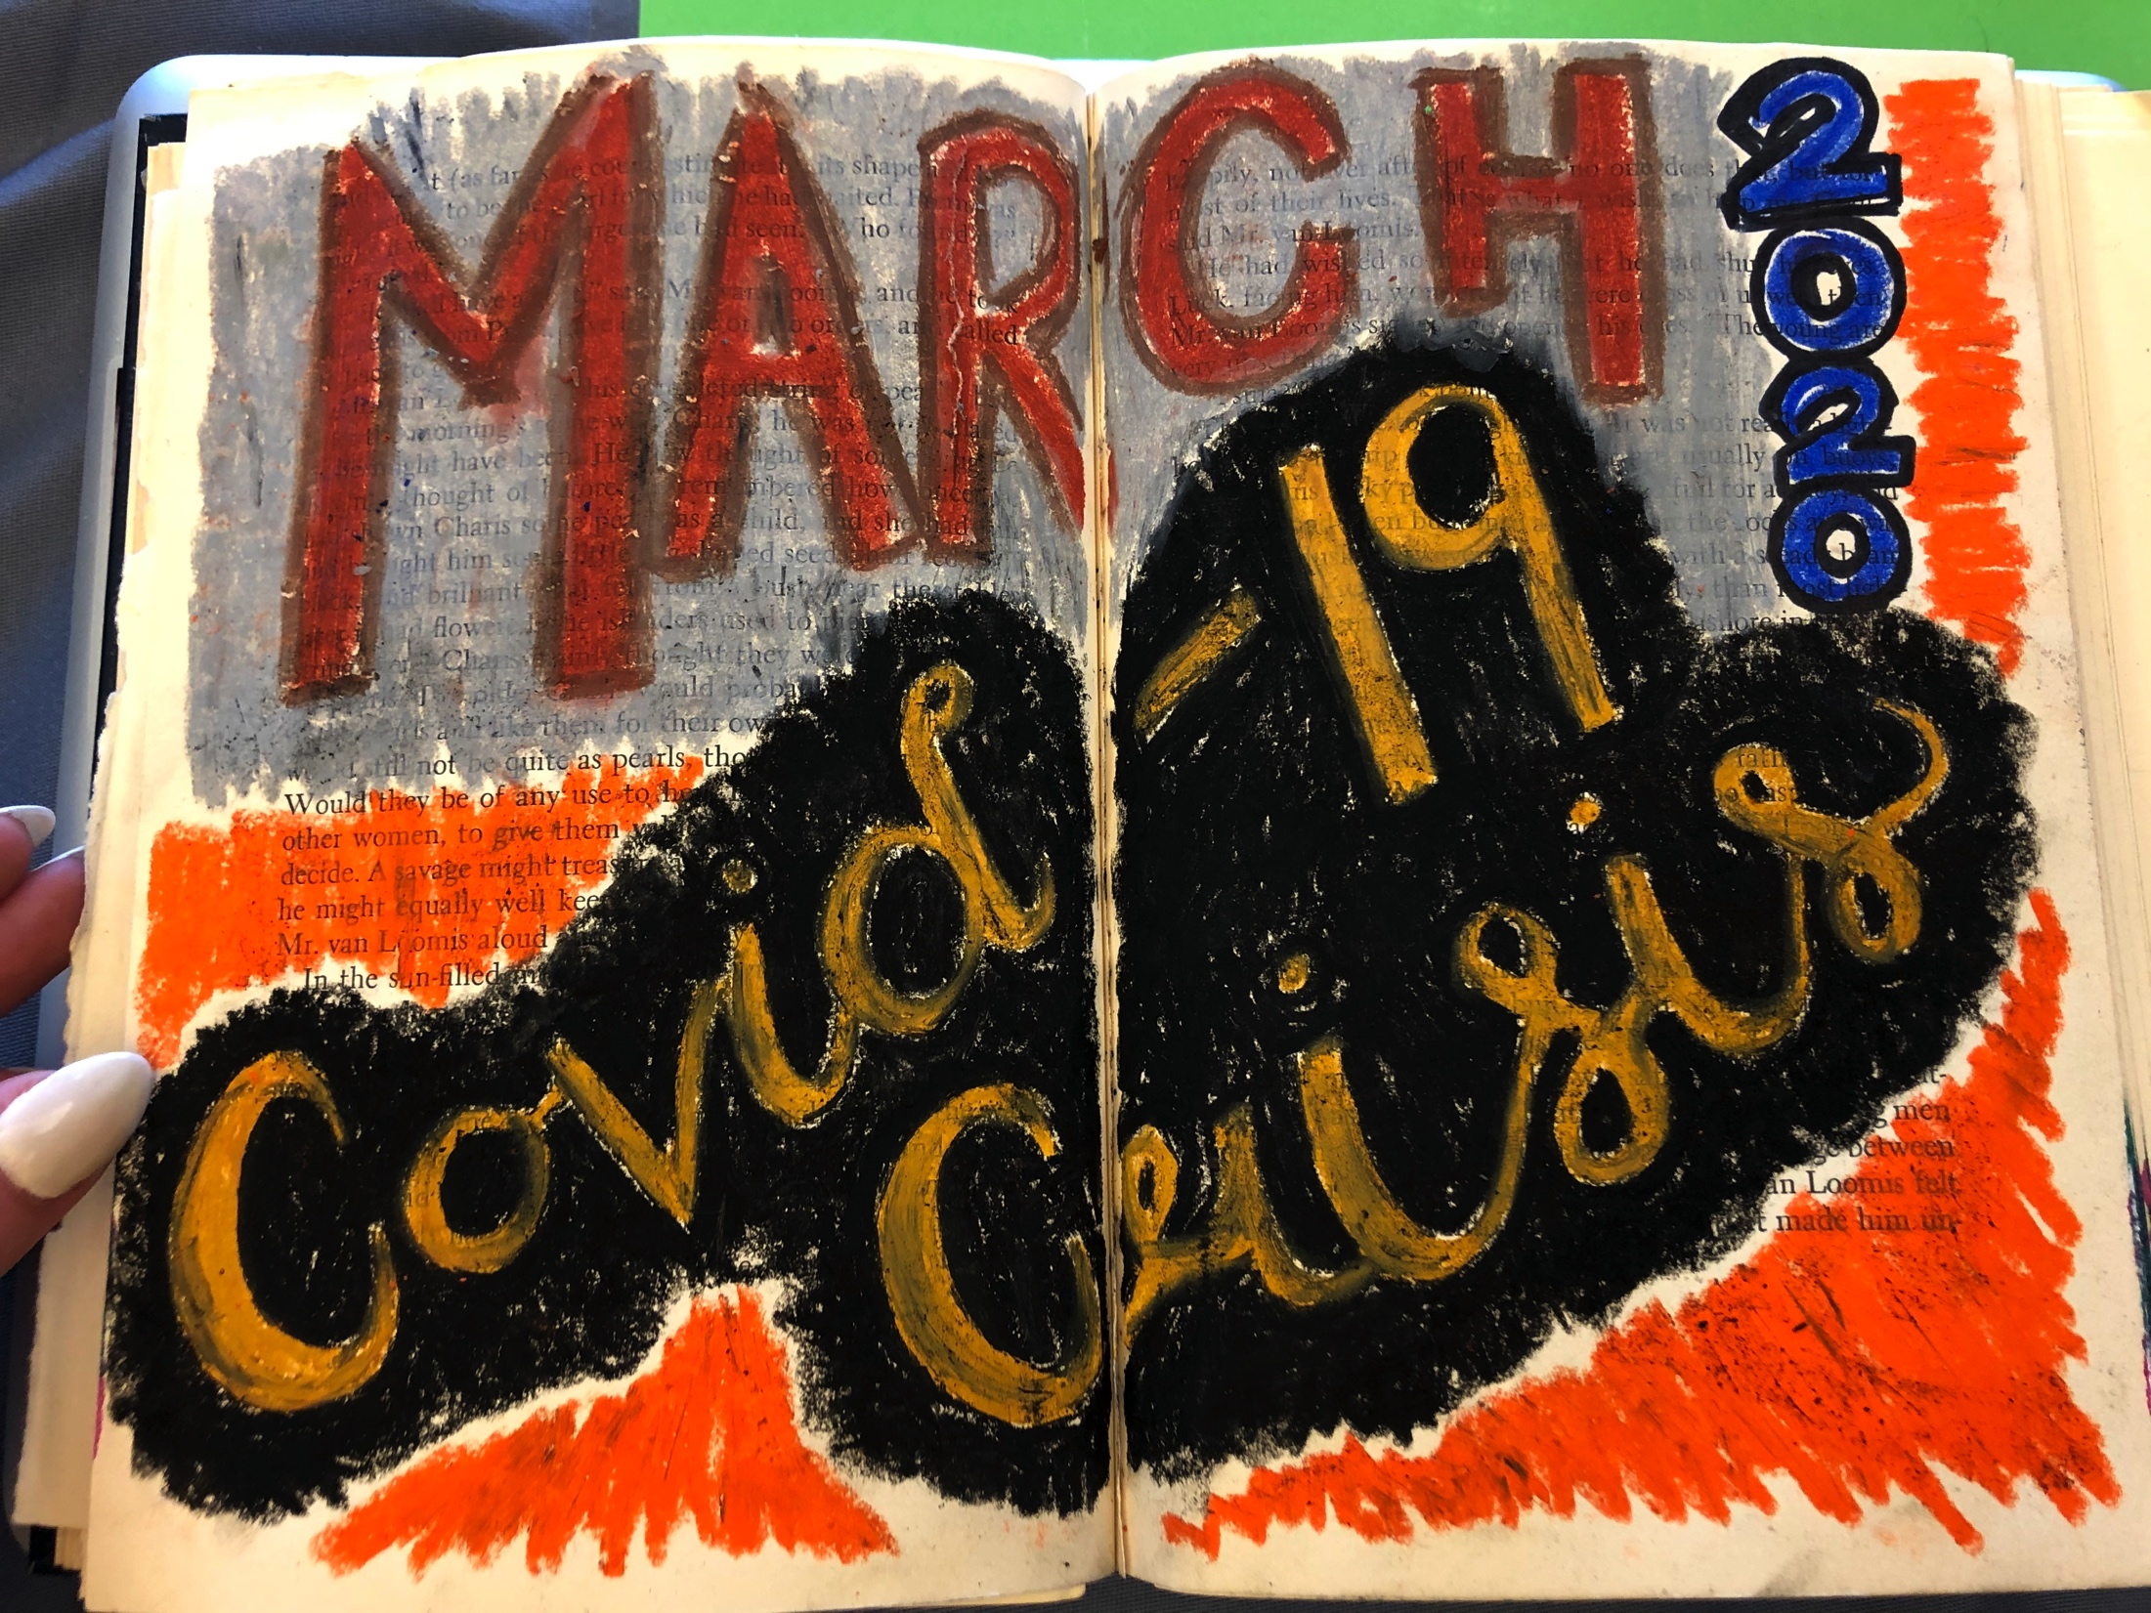
March 20, 2020
This piece was a pastel depiction of how this crisis is making me feel inside.
The black represents some dread, as well as alarm from the orange.
Everyone at StoneCrest and at my job with seniors are freaking out and its hard to stay calm.

Slide 23
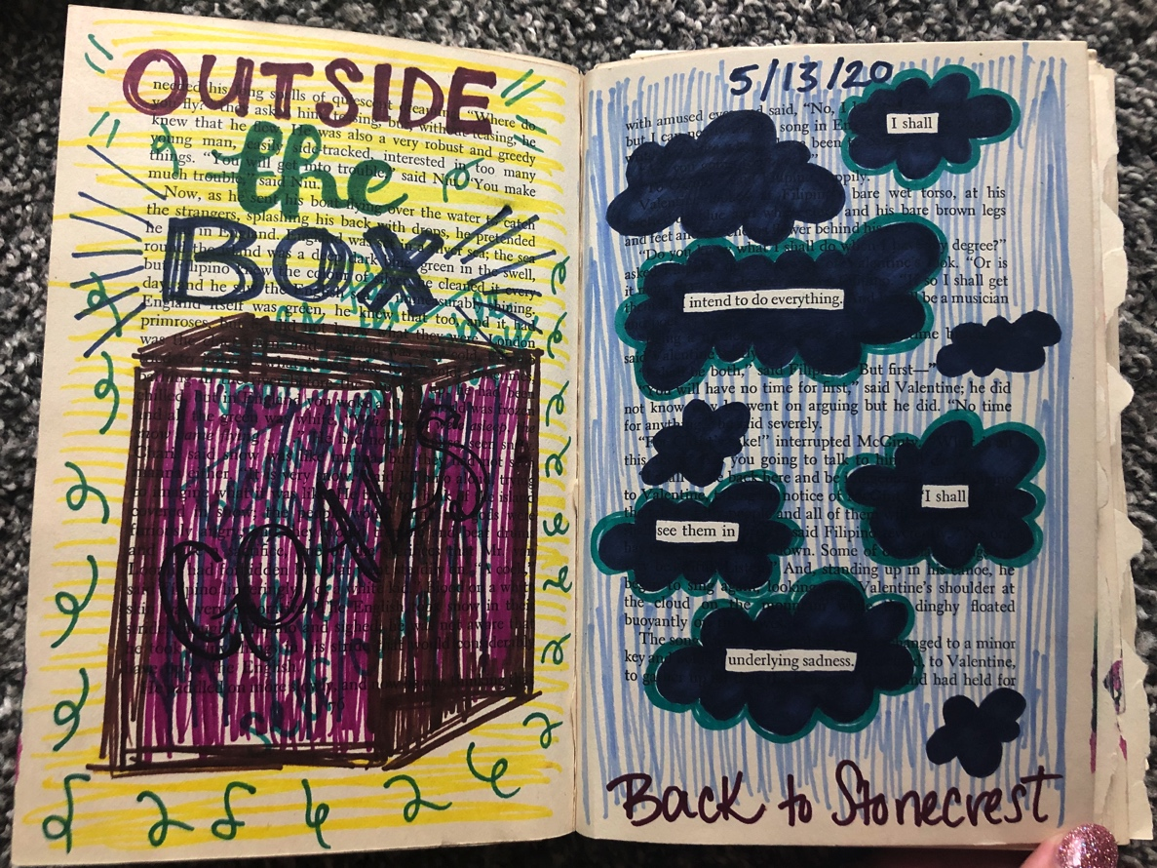
May 13, 2020
This was my first piece after I returned to my internship after being off for over a month due to Covid-19.
Initially I had stopped going because I was afraid of contracting the coronavirus, but I ended up getting it anyway at work. I was sick for 6 weeks.
This is a depiction of a new way of thinking for the rest of internship.

Slide 24
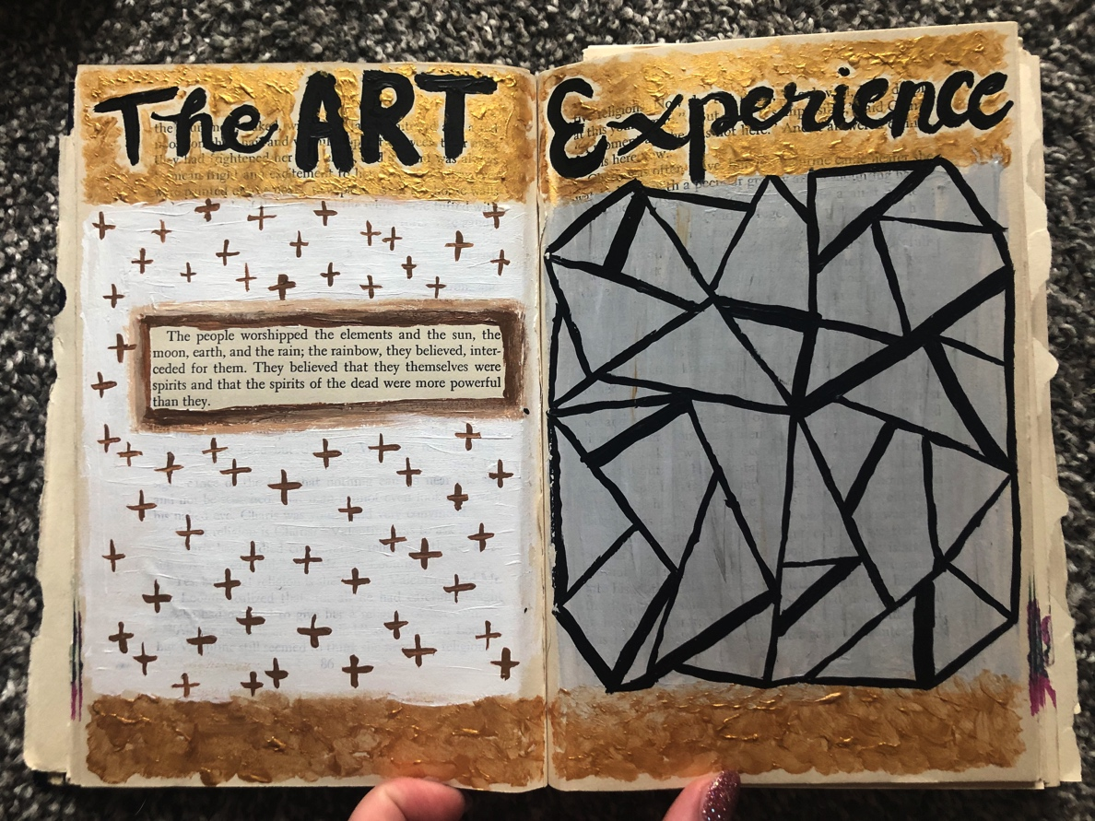
May 14, 2020
This piece was created after my first open studio with the Art Experience.
Open studio was conducted online due to Covid-19, and it was definitely an experience.
I tried to represent a stained glass effect with acrylic paint. The whole online thing seemed fragile and foggy.

Slide 25
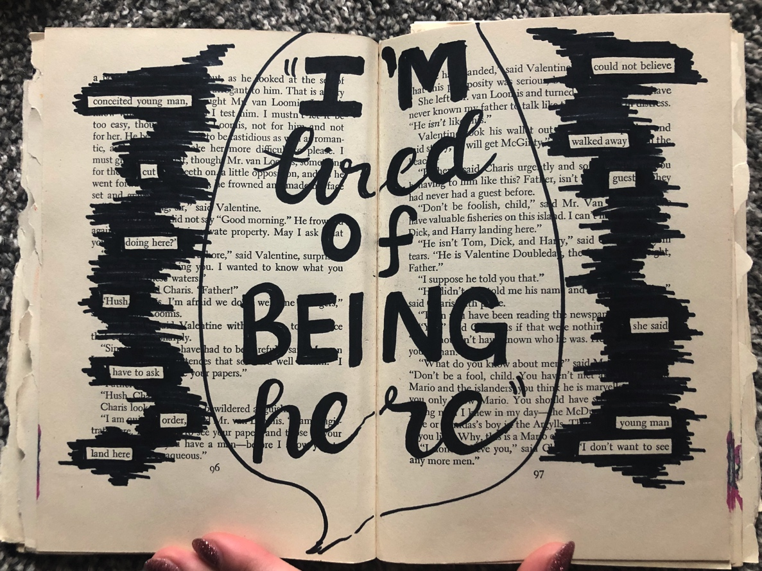
May 27, 2020
This piece was inspired by one of my patients. He kept saying “I’m tired of being here” every time I came onto the unit.
At this point I began to feel similarly, but in relation to not seeing an end in sight in internship or in Covid-19.
I included some inspired blackout poetry on each side.

Slide 26
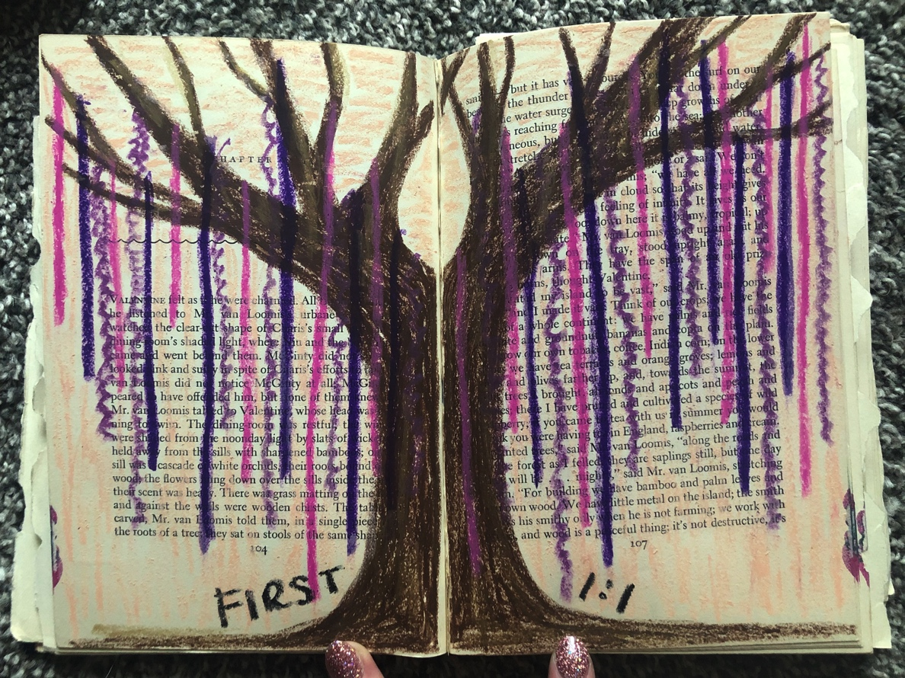
June 11, 2020
This piece was inspired by my first one on one art therapy session at StoneCrest.
The tree is done with oil pastels which is my most comforting medium.
I felt accomplished and happy because I actually enjoyed it whereas I didn’t know if I would.

Slide 27
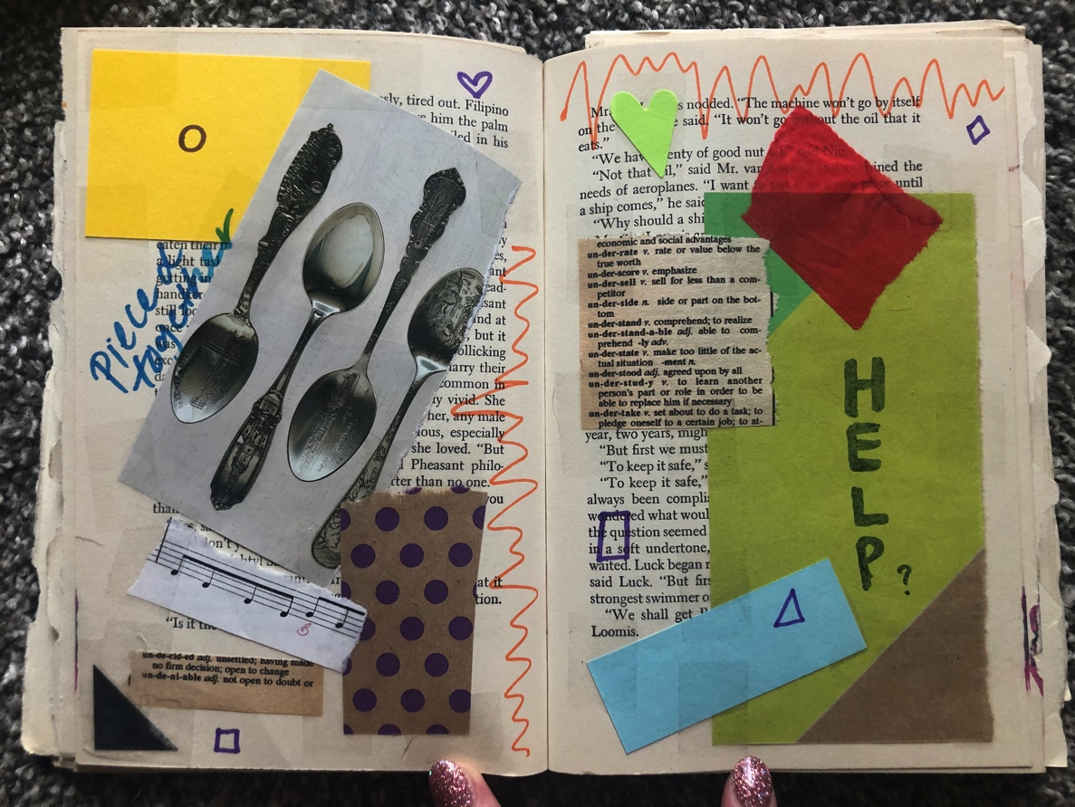
June 24, 2020
This piece was a inspired by the fact that the end of the semester was rapidly approaching and I felt like I was trying to piece together everything in time for graduation.
I also started taking on more groups and responsibilities at StoneCrest.

Slide 28

July 1, 2020
This piece was a pastel depiction of how my feelings feel so opposite about the end of the semester next month.
On one side, I am excited for everything to be over.
On the other side, I am anxious that everything won’t be completed in time.
Somehow they are similar feelings.

Slide 29
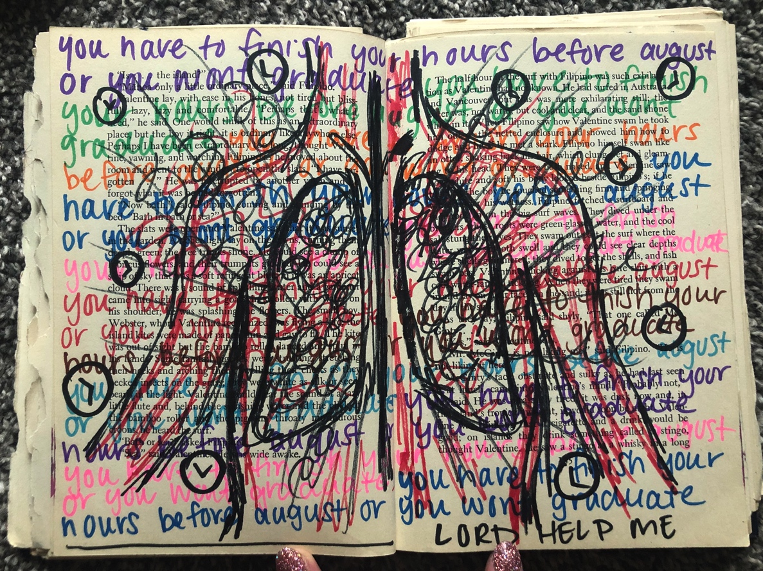
July 6, 2020
This piece was done with sharpies.
Originally it was to represent the anxiety I’ve been feeling about finishing all of my hours.
Afterward, I realized it could also be another indication of the anxiety that Covid-19 itself has caused.

Slide 30
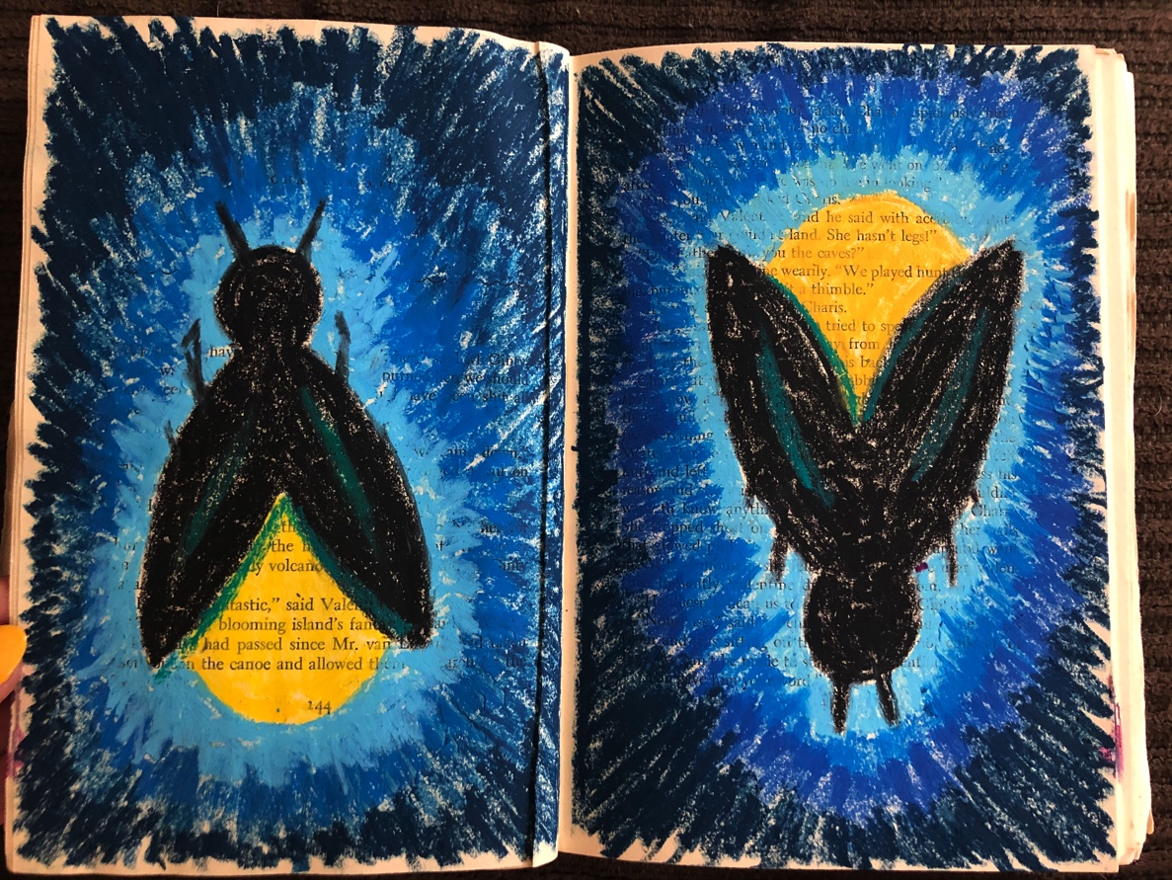
July 15, 2020
This piece was done with oil pastels.
It represents the light at the end of the tunnel with internship.
Groups have become way more comfortable and I’m finally seeing an end in sight hours wise.
The lightning bugs are my symbol of hope.

Slide 31
Conclusion
I have learned a lot more about crisis, inpatient settings, and mental health since being at StoneCrest Center.
I have learned a lot of valuable things about both group art therapy and individual art therapy.
I have learned a lot about groups not going as planned and figuring out something else to do in the moment.
I plan on accepting the position as their staff art therapist in the activity therapy department once I receive my degree.

Slide 32
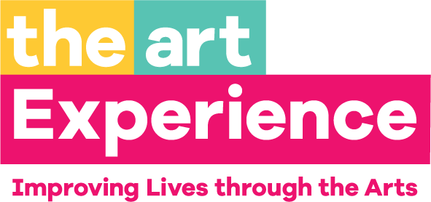
Conclusion
Unfortunately, I didn’t get to spend any time at the studio at The Art Experience due to Covid-19.
I helped with several online Open Studios and it helped me get used to online sessions with clients.
It was difficult because I didn’t know what types of art supplies they would have at home, or if they would be motivated to make art.
I also built some relationships with other Art Therapists here.

Slide 33

Potential Job Sites
Inpatient
StoneCrest Center – Detroit
Harbor Oaks – New Baltimore
IOP’s
New Oakland Family Centers – Clarkston
River’s Bend – Detroit
Bald Mountain Behavioral Medicine – Lake Orion

